Slide 1
Generalized Slow Feature Analysis
Vishal Rishi MK, IDDD DS
1
Notes:
ID=d924773e-9a16-4d6d-9803-8cb819e99682 Recipe=text_billboard Type=TextOnly Variant=0 FamilyID=AccentBoxWalbaum_Zero

Slide 2

Agenda
Introduction
Mathematical Background - SFA
Motivation and Objectives
Problem Statement – GSFA
Linear GSFA
Special Remarks on the Filter, $G$
Probabilistic GSFA
Applications / Case Studies
Work Ahead
References
Appendix

Slide 3
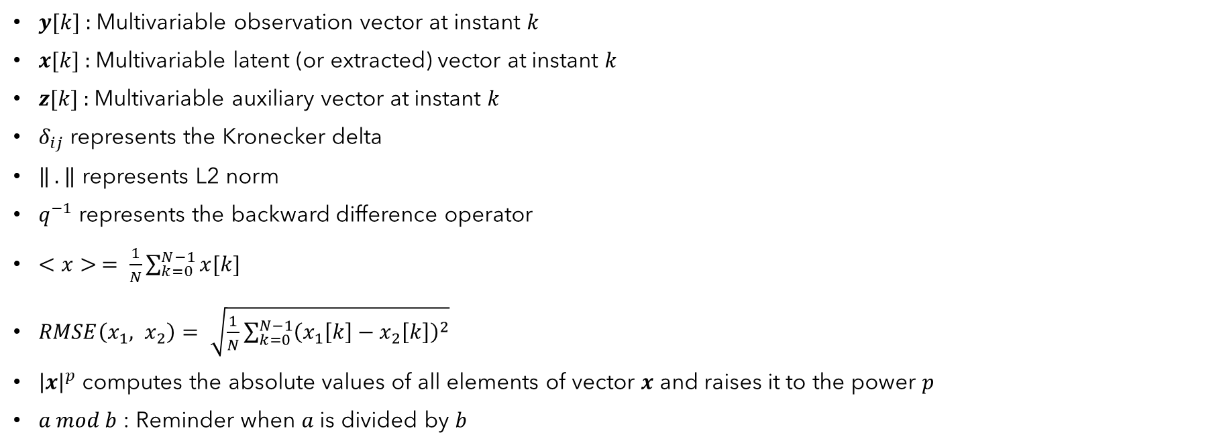
Table of Notations
$y[k]$ : Multivariable observation vector at instant $k$
$x[k]$ : Multivariable latent (or extracted) vector at instant $k$
$z[k]$ : Multivariable auxiliary vector at instant $k$
$δ_{ij}$ represents the Kronecker delta
$\left\| . \right\|$ represents L2 norm
$q^{−1}$ represents the backward difference operator
$<x> = \frac{1}{N}\sum_{k=0}^{N−1}{x[k]}$
$RMSE\left(x_{1}, x_{2}\right)= \sqrt{\frac{1}{N}\sum_{k=0}^{N−1}{{\left(x_{1}\left[k\right]−x_{2}\left[k\right]\right)}^{2}}}$
${\left|x\right|}^{p}$ computes the absolute values of all elements of vector $x$ and raises it to the power $p$
$a mod b$ : Reminder when $a$ is divided by $b$

Slide 4
Introduction
Slow Feature Analysis (SFA) was originally developed as an abstract model of unsupervised learning of invariances in the visual system of primates
SFA is based on the “slowness principle” which is stated below:
Primary sensory signals, which in general code for local properties, vary quickly while the perceived environment changes slowly. If one succeeds in extracting slow features from the quickly varying sensory signal, one is likely to obtain an invariant representation of the environment (refer Appendix)

Slide 5
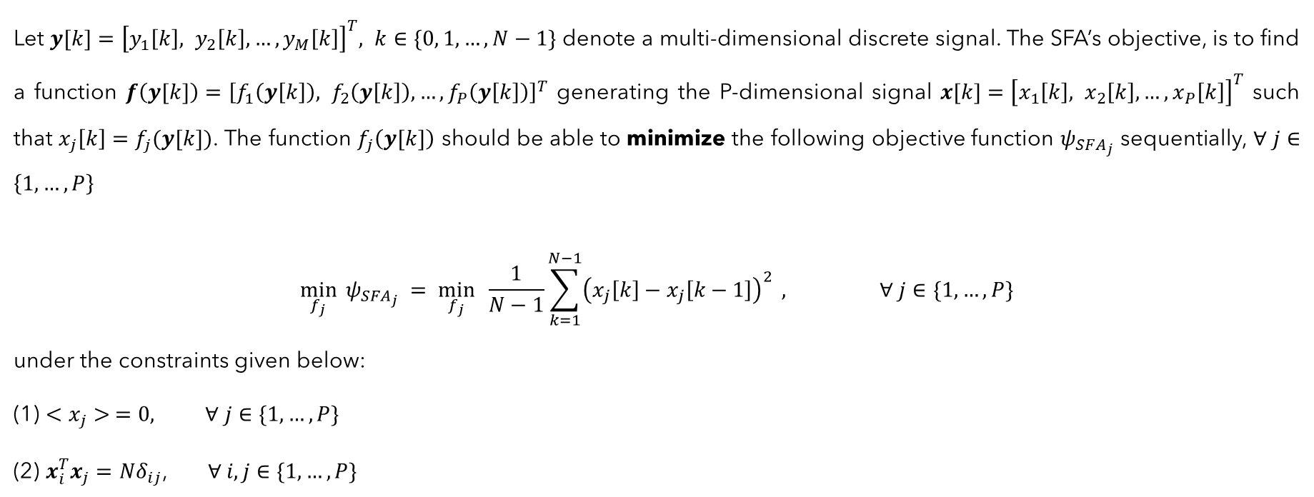
Mathematical Background - SFA
Let $y[k]={\left[y_{1}\left[k\right], y_{2}\left[k\right], …, y_{M}\left[k\right]\right]}^{T}, k∈\{0, 1, …, N−1\}$ denote a multi-dimensional discrete signal. The SFA’s objective, is to find a function $f\left(y[k]\right)={\left[f_{1}\left(y\left[k\right]\right), f_{2}\left(y\left[k\right]\right), …, f_{P}\left(y\left[k\right]\right)\right]}^{T}$ generating the P-dimensional signal $x[k]={\left[x_{1}\left[k\right], x_{2}\left[k\right], …, x_{P}\left[k\right]\right]}^{T}$ such that $x_{j}\left[k\right]=f_{j}(y[k])$. The function $f_{j}\left(y[k]\right)$ should be able to minimize the following objective function $ψ_{SFA_{j}}$ sequentially, $∀ j∈\left\{1, …,P\right\}$
$$\min_{f_{j}}{ψ_{SFA_{j}} = \min_{f_{j}}{ \frac{1}{N−1}\sum_{k=1}^{N−1}{{\left(x_{j}\left[k\right]−x_{j}\left[k−1\right]\right)}^{2}}}} , ∀ j∈\{1, …,P\}$$
under the constraints given below:
(1) $<x_{j}> =0,$ $∀ j∈\{1, …,P\}$
(2) $x_{i}^{T}x_{j}={Nδ}_{ij}$, $∀ i, j∈\{1, …,P\}$
(1)

Slide 6




Motivation and Objectives
“Slowness” can be better described in frequency domain
SFA can be thought of as ($q^{−1}$ is the backward difference operator):
$$G_{SFA}\left(q^{−1}\right)=1−q^{−1}$$
$$x[k]$$
$$z[k]$$

Slide 7
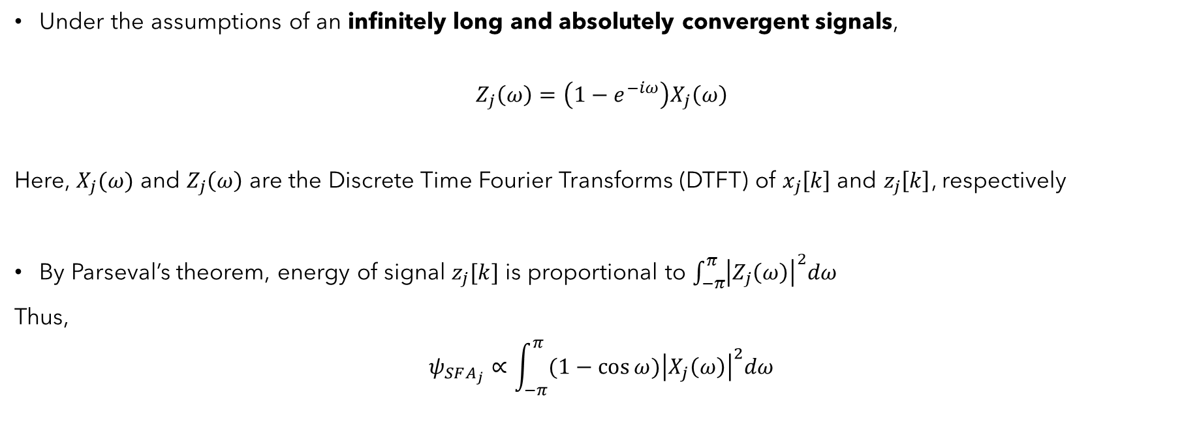
Motivation and Objectives
Under the assumptions of an infinitely long and absolutely convergent signals,
$$Z_{j}\left(ω\right)=\left(1−e^{−iω}\right)X_{j}\left(ω\right)$$
Here, $X_{j}(ω)$ and $Z_{j}\left(ω\right)$ are the Discrete Time Fourier Transforms (DTFT) of $x_{j}\left[k\right]$ and $z_{j}\left[k\right]$, respectively
By Parseval’s theorem, energy of signal $z_{j}[k]$ is proportional to $\int_{−π}^{π}{{\left|Z_{j}\left(ω\right)\right|}^{2}dω}$
Thus,
$$ψ_{SFA_{j}}∝\int_{−π}^{π}{{(1−\cos{ω})\left|X_{j}\left(ω\right)\right|}^{2}dω}$$
(2)
(3)

Slide 8
Motivation and Objectives
The objectives are stated as follows:
To come up with a straightforward and a general objective function in the frequency domain
To obtain a closed-form expression for the optimization of the new objective function. We call this procedure as the Generalized Slow Feature Analysis (GSFA)
To take into account the stochasticity of the observation signals
To illustrate the advantages of the proposed methods in tasks like state estimation and classification

Slide 9
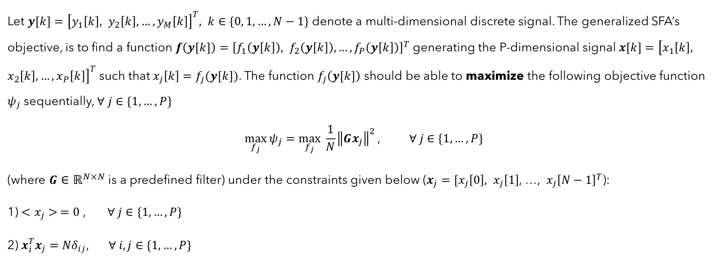
Problem Statement – GSFA
Let $y[k]={\left[y_{1}\left[k\right], y_{2}\left[k\right], …, y_{M}\left[k\right]\right]}^{T}, k∈\{0, 1, …, N−1\}$ denote a multi-dimensional discrete signal. The generalized SFA’s objective, is to find a function $f\left(y[k]\right)={\left[f_{1}\left(y\left[k\right]\right), f_{2}\left(y\left[k\right]\right), …, f_{P}\left(y\left[k\right]\right)\right]}^{T}$ generating the P-dimensional signal $x[k]={\left[x_{1}\left[k\right], x_{2}\left[k\right], …, x_{P}\left[k\right]\right]}^{T}$ such that $x_{j}\left[k\right]=f_{j}(y[k])$. The function $f_{j}\left(y[k]\right)$ should be able to maximize the following objective function $ψ_{j}$ sequentially, $∀ j∈\{1, …,P\}$
$$\max_{f_{j}}{ψ_{j}}=\max_{f_{j}}{ \frac{1}{N}{\left\|Gx_{j}\right\|}^{2}}\text{, } ∀ j∈\{1, …,P\}$$
(where $G∈ℝ^{N×N}$ is a predefined filter) under the constraints given below ($x_{j}=[x_{j}\left[0\right], x_{j}\left[1\right]$, …, $x_{j}{\left[N−1\right]}^{T}$):
1) $<x_{j}> =0$ , $∀ j∈\{1, …,P\}$
2) $x_{i}^{T}x_{j}={Nδ}_{ij}$, $∀ i, j∈\{1, …,P\}$
(4)

Slide 10
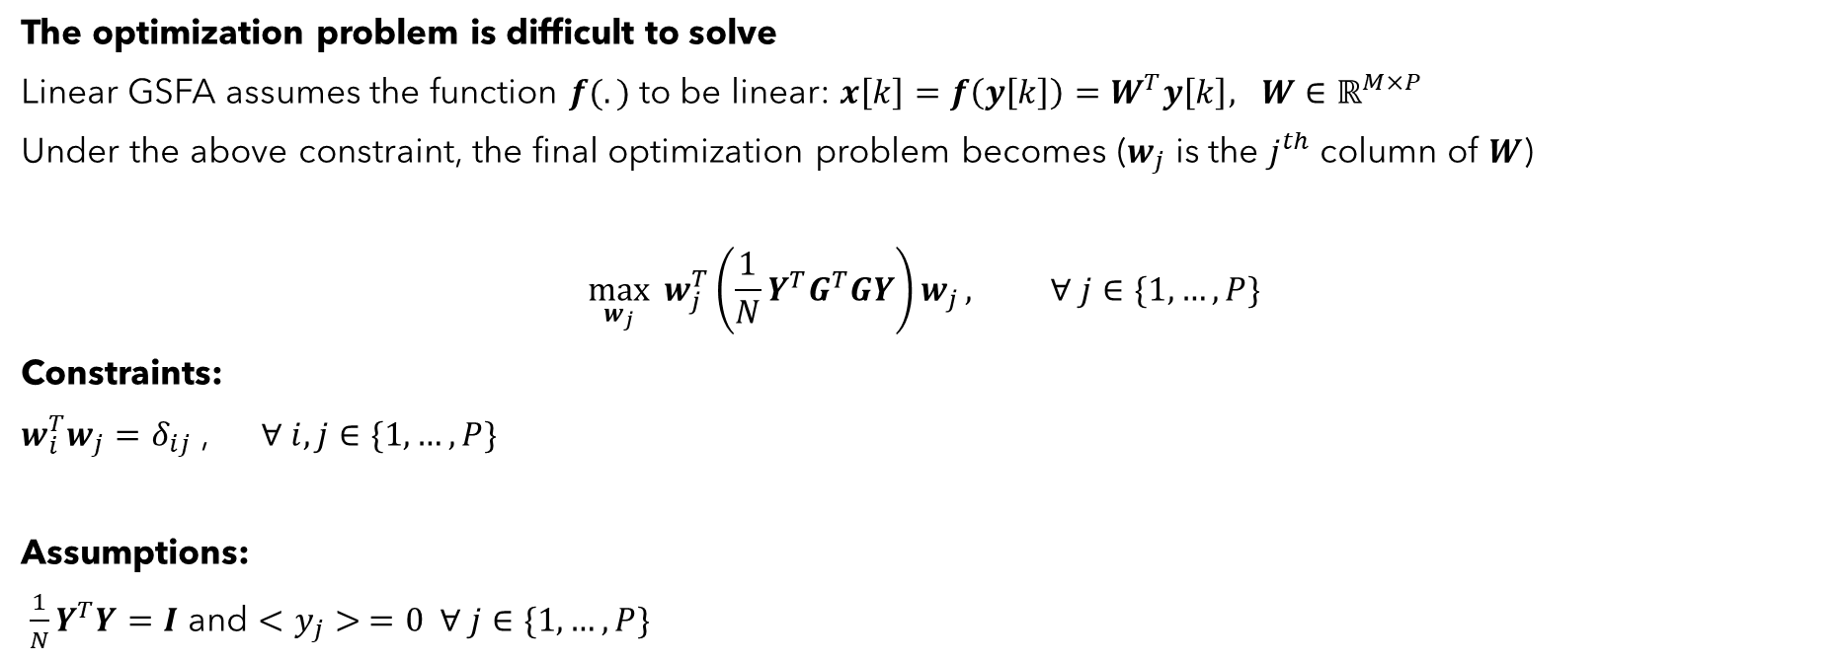
Linear GSFA
The optimization problem is difficult to solve
Linear GSFA assumes the function $f(.)$ to be linear: $x\left[k\right]=f\left(y\left[k\right]\right)=W^{T}y\left[k\right], W∈ℝ^{M×P}$
Under the above constraint, the final optimization problem becomes ($w_{j}$ is the $j^{th}$ column of $W$)
$$\max_{w_{j}}{w_{j}^{T}\left(\frac{1}{N}Y^{T}G^{T}GY\right)w_{j}}, ∀ j∈\{1, …,P\}$$
Constraints:
$w_{i}^{T}w_{j}=δ_{ij}$ , $∀ i, j∈\{1, …,P\}$
Assumptions:
$\frac{1}{N}Y^{T}Y=I$ and $<y_{j}> =0 ∀ j∈\{1, …,P\}$
(5)

Slide 11
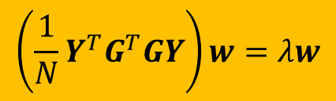
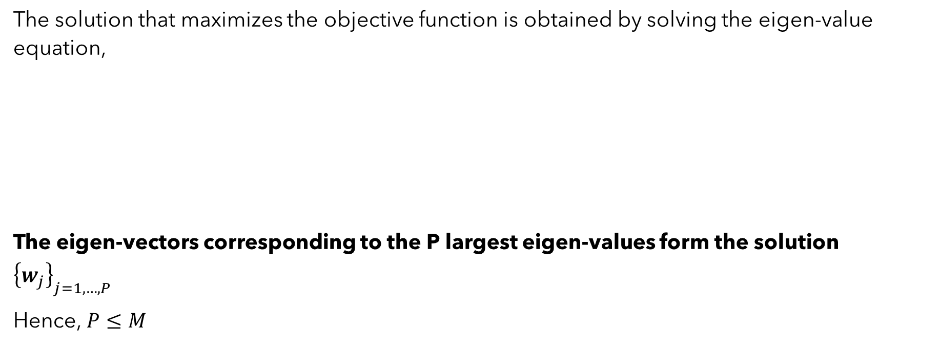
Linear GSFA
The solution that maximizes the objective function is obtained by solving the eigen-value equation,
The eigen-vectors corresponding to the P largest eigen-values form the solution ${\left\{w_{j}\right\}}_{j=1,…,P}$
Hence, $P≤M$
$$\left(\frac{1}{N}Y^{T}G^{T}GY\right)w=λw$$
(6)

Slide 12
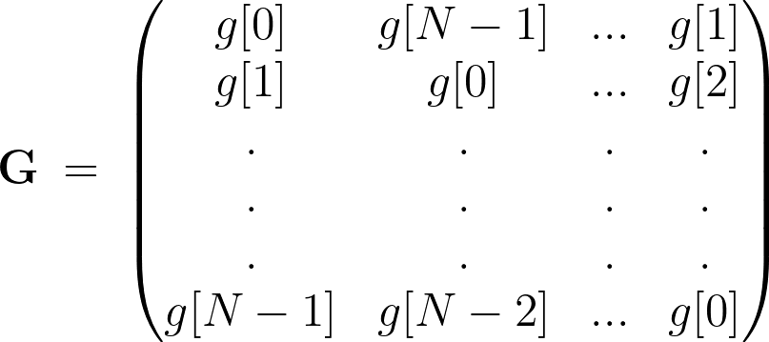

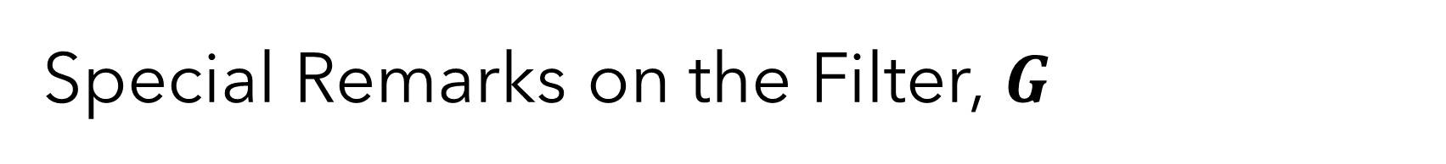
Special Remarks on the Filter, $G$
The matrix $G∈ℝ^{N×N}$ in the objective function is given by
Here $g[k]$ is the impulse response coefficients of a filter $G(q^{−1})$, specified by the user

Slide 13
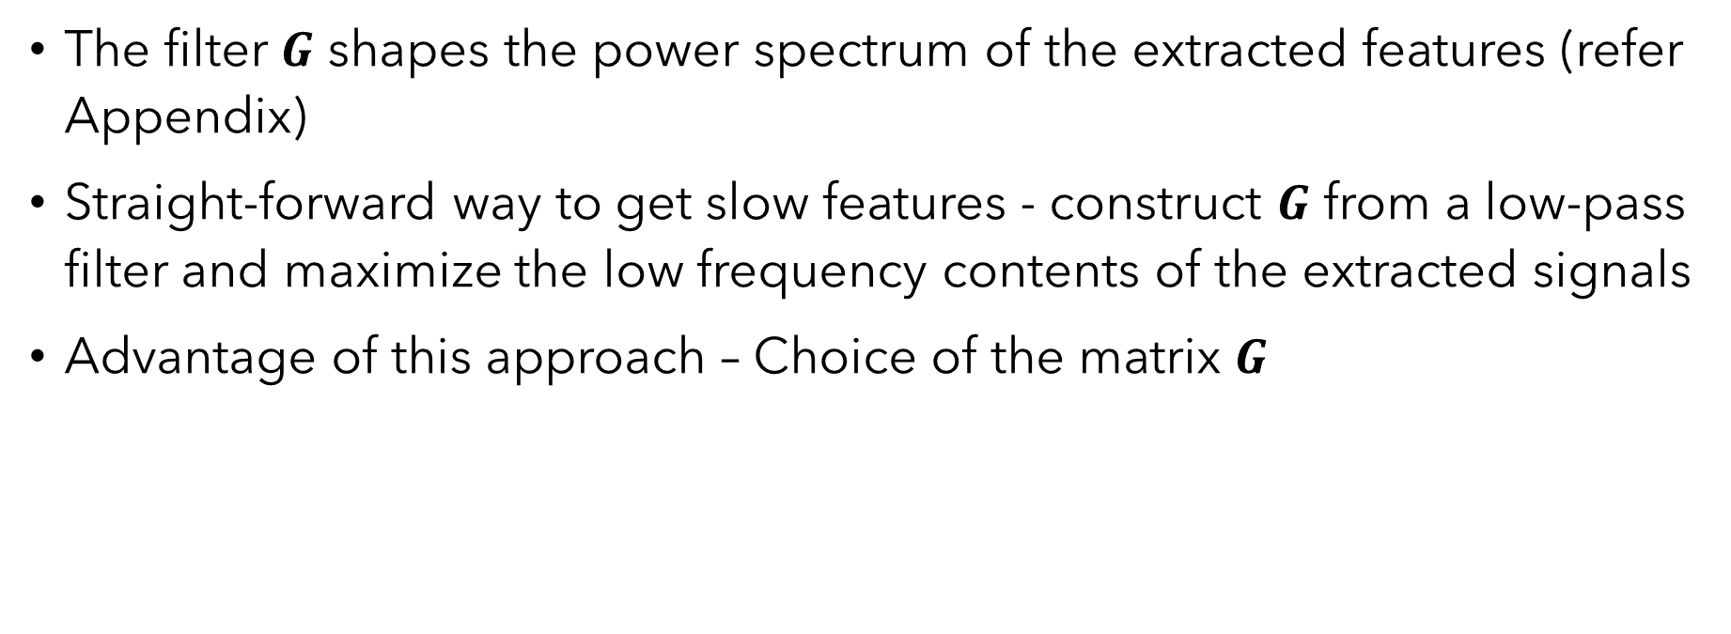
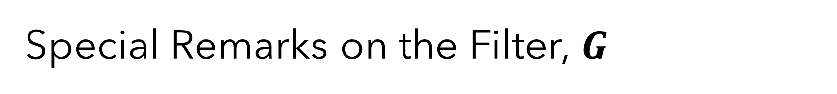
Special Remarks on the Filter, $G$
The filter 𝑮 shapes the power spectrum of the extracted features (refer Appendix)
Straight-forward way to get slow features - construct 𝑮 from a low-pass filter and maximize the low frequency contents of the extracted signals
Advantage of this approach – Choice of the matrix $G$
Standard linear SFA becomes a special case of linear GSFA when $G\left(q^{−1}\right)=1+q^{−1}$

Slide 14
Probabilistic Generalized Slow Feature Analysis

Slide 15
Need for a Probabilistic Model
GSFA assumes deterministic signals
Need for taking into account the stochastic nature of signals
Areas like process monitoring, state estimation, behavior analysis etc.

Slide 16
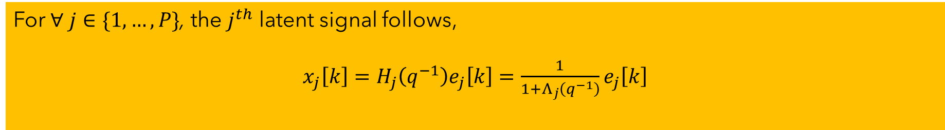
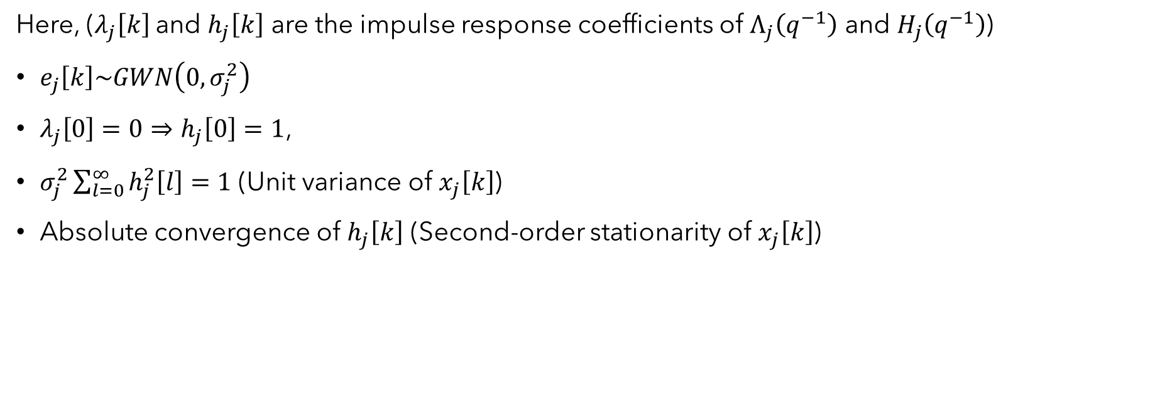
Prior: Latent Signals
For $∀ j∈\{1, …,P\}$, the $j^{th}$ latent signal follows,
$x_{j}\left[k\right]=H_{j}\left(q^{−1}\right)e_{j}\left[k\right]=\frac{1}{1+Λ_{j}\left(q^{−1}\right)}e_{j}\left[k\right]$
(7)
Here, ($λ_{j}\left[k\right]$and $h_{j}\left[k\right]$ are the impulse response coefficients of $Λ_{j}\left(q^{−1}\right)$ and $H_{j}\left(q^{−1}\right)$)
$e_{j}\left[k\right]\sim GWN\left(0,σ_{j}^{2}\right)$
$λ_{j}\left[0\right]=0⇒h_{j}\left[0\right]=1$,
$σ_{j}^{2}\sum_{l=0}^{∞}{h_{j}^{2}\left[l\right]=1}$ (Unit variance of $x_{j}\left[k\right]$)
Absolute convergence of $h_{j}\left[k\right]$ (Second-order stationarity of $x_{j}\left[k\right]$)

Slide 17


Generative model – Observation Signals
The observation signal $y\left[k\right]∈ℝ^{M×1}$ follows,
$$y\left[k\right]=f_{φ}\left(x\left[k\right]\right)+ε\left[k\right]$$
(8)
Here,
$ε\left[k\right]\sim GWN\left(0,σ_{ε}^{2}I_{M×M} \right)$ (Measurement noise)
$f_{φ}\left(.\right)$ is a function parameterized by $φ$
If $f_{φ}\left(x\left[k\right]\right)=Wx\left[k\right], W∈ℝ^{M×P}$ - Linear Probabilistic GSFA

Slide 18
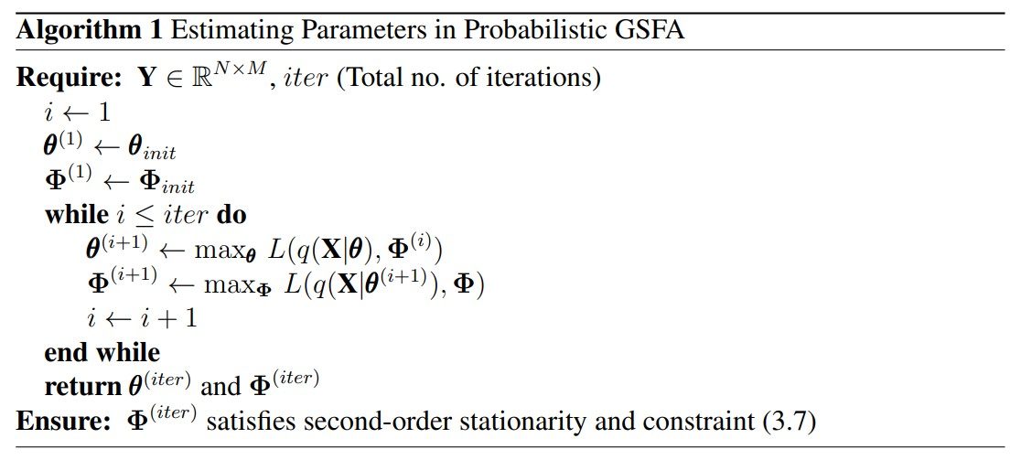
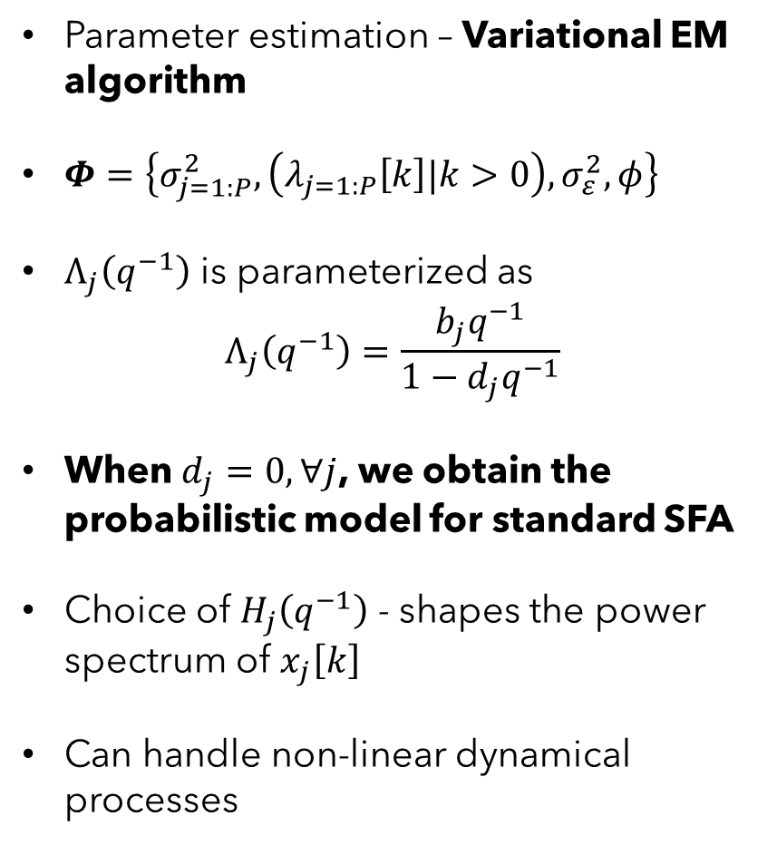
Estimation of Parameters
Parameter estimation – Variational EM algorithm
$Φ=\left\{σ_{j=1:P}^{2},\left(λ_{j=1:P}\left[k\right]|k>0\right),σ_{ε}^{2},φ\right\}$
$Λ_{j}\left(q^{−1}\right)$ is parameterized as
$$Λ_{j}\left(q^{−1}\right)=\frac{b_{j}q^{−1}}{1−d_{j}q^{−1}}$$
When $d_{j}=0, ∀j$, we obtain the probabilistic model for standard SFA
Choice of $H_{j}\left(q^{−1}\right)$ - shapes the power spectrum of $x_{j}\left[k\right]$
Can handle non-linear dynamical processes

Slide 19
Applications / Case Studies

Slide 20
Applications / Case Studies
Three case studies:
State Estimation
German Traffic Sign Recognition Benchmark (GTSRB)
Fault Classification in the Tennessee Eastman (TE) process
Main advantages of GSFA (and probabilistic GSFA) we wish to demonstrate through these case studies:
Choice of the filter
Modelling of process and measurement noise
Ease of handling non-linearities using probabilistic GSFA without relying on non-linear expansions

Slide 21
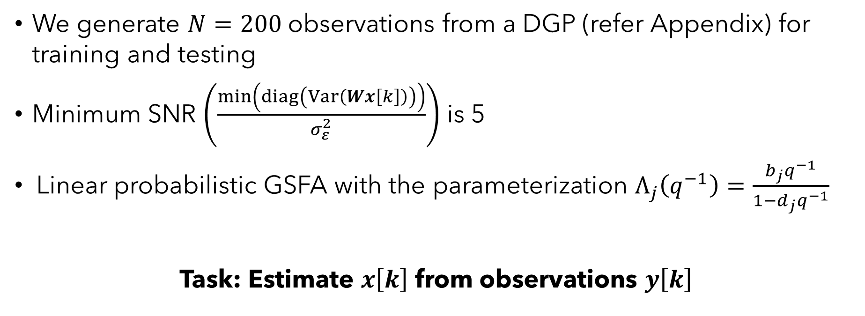
State Estimation
We generate $N=200$ observations from a DGP (refer Appendix) for training and testing
Minimum SNR $\left(\frac{\min\left(diag\left(Var\left(Wx\left[k\right]\right)\right)\right)}{σ_{ε}^{2}}\right)$ is 5
Linear probabilistic GSFA with the parameterization $Λ_{j}\left(q^{−1}\right)=\frac{b_{j}q^{−1}}{1−d_{j}q^{−1}}$
Task: Estimate $x\left[k\right]$ from observations $y\left[k\right]$

Slide 22
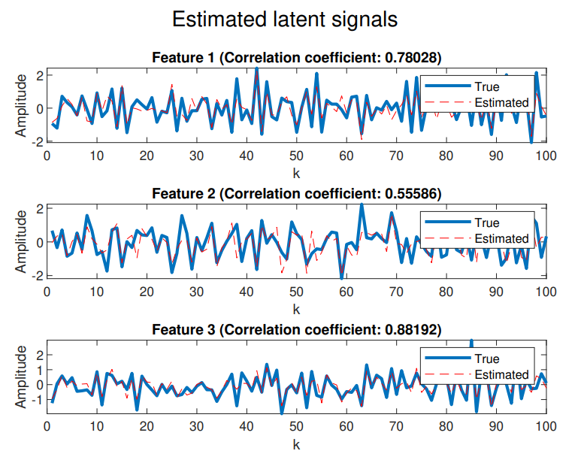
True and Estimated Latent Signals
 | Avg. corr. coef. b/w true and estimated latents
Method | Latent signal 1 | Latent signal 2 | Latent signal 3
Probabilistic GSFA | 0.7627 (±0.03) | 0.6447 (±0.04) | 0.895 (±0.02)
This table shows the average correlation coefficient between each of the true and estimated latent signals obtained from 100 realizations of the test data. The standard deviation is shown in brackets
Fig: True and Estimated Latent Signals

Slide 23
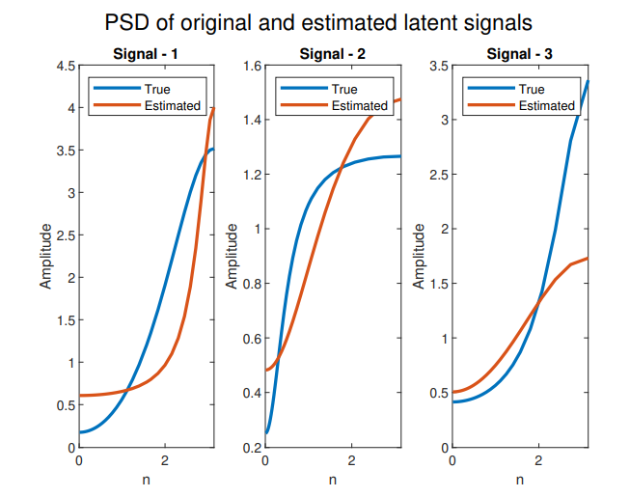
Power Spectrum of Latent Signals
The PSD of the estimated latent signals has a similar shape to that of the true latent signals (with predominantly high-frequency content)
Probabilistic GSFA gives the freedom for extracting signals with a desired frequency content (not just slow signals!)
Fig: PSD of true and estimated latent signals

Slide 24
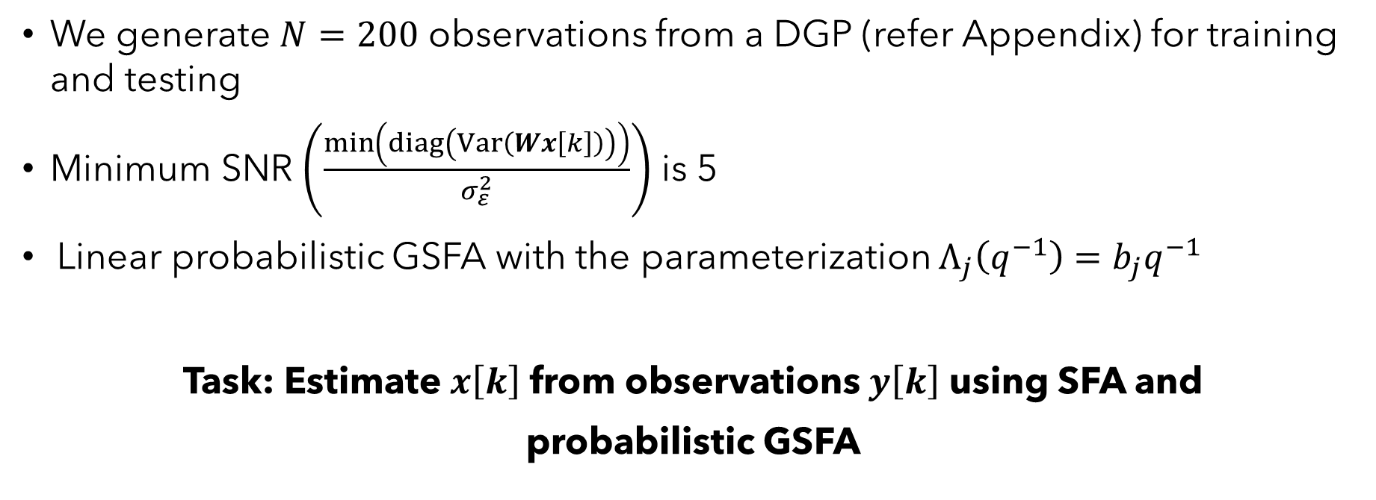
Comparison between SFA and Probabilistic GSFA
We generate $N=200$ observations from a DGP (refer Appendix) for training and testing
Minimum SNR $\left(\frac{\min\left(diag\left(Var\left(Wx\left[k\right]\right)\right)\right)}{σ_{ε}^{2}}\right)$ is 5
Linear probabilistic GSFA with the parameterization $Λ_{j}\left(q^{−1}\right)=b_{j}q^{−1}$
Task: Estimate $x\left[k\right]$ from observations $y\left[k\right]$ using SFA and
probabilistic GSFA

Slide 25
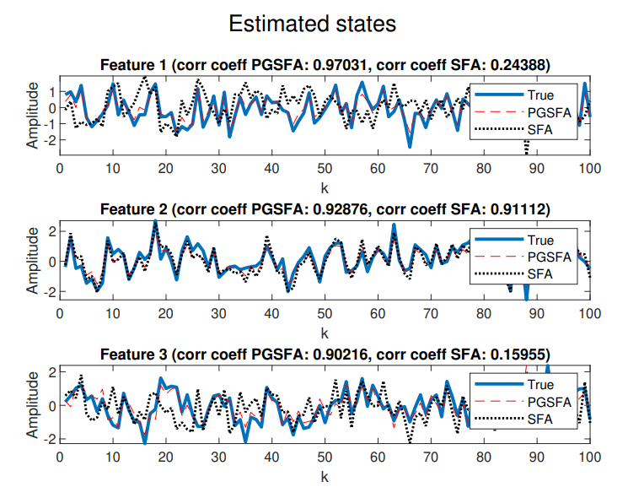
True and Estimated Latent Signals
 | Avg. corr. coef. b/w true and estimated latents
Method | Latent signal 1 | Latent signal 2 | Latent signal 3
Probabilistic GSFA | 0.971 (±0.004) | 0.9214 (±0.01) | 0.9057 (±0.01)
Standard SFA | 0.2113 (±0.07) | 0.9006 (±0.01) | 0.1382 (±0.07)
This table shows the average correlation coefficient between each of the true and estimated latent signals obtained from 100 realizations of the test data. The standard deviation is shown in brackets
Fig: Comparing SFA and probabilistic GSFA

Slide 26
German Traffic Sign Recognition Benchmark (GTSRB)
GTSRB – 43 different traffic signs under uncontrolled conditions
Variations in lighting, sign size, distance etc.
Training images – 39,209
Testing images – 12,630
Task: Compare standard SFA with GSFA and probabilistic GSFA on the GTSRB
To ensure fair comparison - all the stages of the pipeline, except feature extraction, are kept the same

Slide 27
Methodology
Preprocessing – resizing, HOG, PCA, sorting
Feature extraction method 1: SFA
Feature extraction method 2: GSFA
Feature extraction method 3: Probabilistic GSFA
Classification head - Gaussian Naive Bayes (GNB)
Imbalanced dataset – Accuracy and weighted F1 metrics
Note: The accuracy of the pipeline can be improved further by choosing a better classifier. For more details, refer Appendix

Slide 28
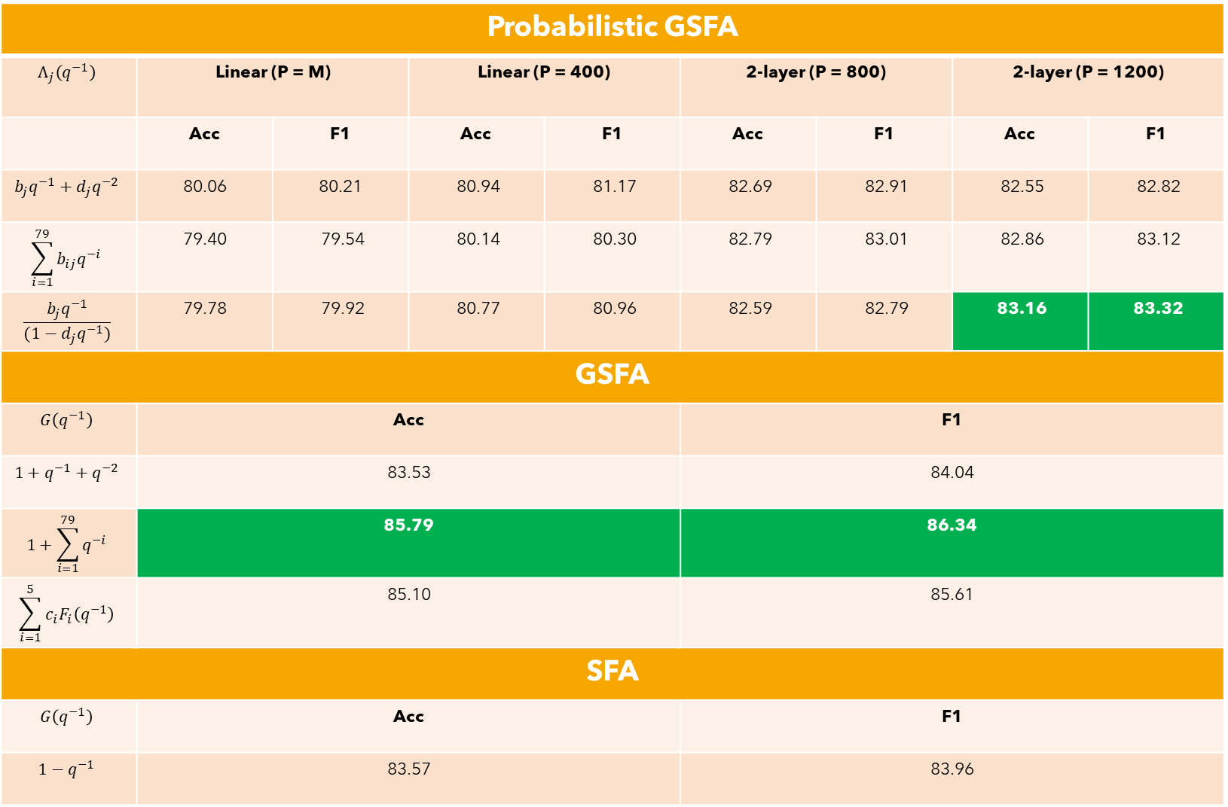
Probabilistic GSFA
$$Λ_{j}\left(q^{−1}\right)$$ | Linear (P = M) |  | Linear (P = 400) |  | 2-layer (P = 800) |  | 2-layer (P = 1200)
 | Acc | F1 | Acc | F1 | Acc | F1 | Acc | F1
$$b_{j}q^{−1}+d_{j}q^{−2}$$ | 80.06 | 80.21 | 80.94 | 81.17 | 82.69 | 82.91 | 82.55 | 82.82
$$\sum_{i=1}^{79}{b_{ij}q^{−i}}$$ | 79.40 | 79.54 | 80.14 | 80.30 | 82.79 | 83.01 | 82.86 | 83.12
$$\frac{b_{j}q^{−1}}{(1−d_{j}q^{−1})}$$ | 79.78 | 79.92 | 80.77 | 80.96 | 82.59 | 82.79 | 83.16 | 83.32
GSFA
$$G\left(q^{−1}\right)$$ | Acc |  |  |  | F1
$$1+q^{−1}+q^{−2}$$ | 83.53 |  |  |  | 84.04
$$1+\sum_{i=1}^{79}{q^{−i}}$$ | 85.79 |  |  |  | 86.34
$$\sum_{i=1}^{5}{c_{i}F_{i}\left(q^{−1}\right)}$$ | 85.10 |  |  |  | 85.61
SFA
$$G\left(q^{−1}\right)$$ | Acc |  |  |  | F1
$$1−q^{−1}$$ | 83.57 |  |  |  | 83.96

Slide 29
Fault Classification in the Tennessee Eastman Process
41 measured variables and 11 manipulated variables
21 different faults are simulated
Training dataset - 480 samples for each fault
Testing dataset - 800 samples for each fault
We exclude faults 3, 9, and 15 as in Huang et al. (2020)
Task: Compare standard SFA with GSFA and probabilistic GSFA on the TE process
To ensure fair comparison - all the stages of the pipeline, except feature extraction, are kept the same

Slide 30
Methodology
Preprocessing – standardization and sorting
Feature extraction method 1: SFA
Feature extraction method 2: GSFA
Feature extraction method 3: Probabilistic GSFA
Classification head – Support Vector Machine (one vs one classification)
Evaluation metrics – Accuracy and weighted F1 metrics
Note:
The accuracy of the pipeline can be improved further by choosing a better classifier
We do not have sufficient details to compare our results with those presented in Huang et al. (2020). For more details, refer Appendix

Slide 31
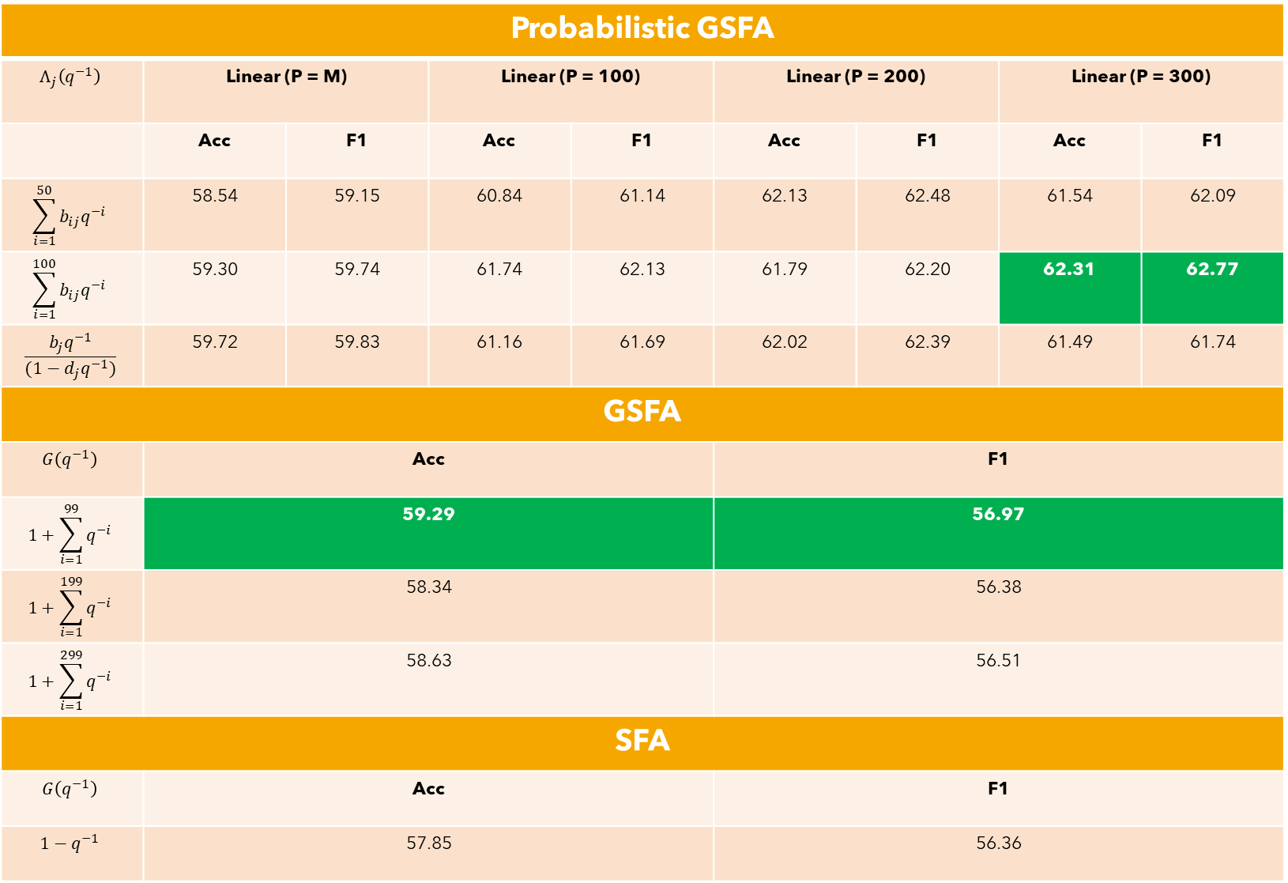
Probabilistic GSFA
$$Λ_{j}\left(q^{−1}\right)$$ | Linear (P = M) |  | Linear (P = 100) |  | Linear (P = 200) |  | Linear (P = 300)
 | Acc | F1 | Acc | F1 | Acc | F1 | Acc | F1
$$\sum_{i=1}^{50}{b_{ij}q^{−i}}$$ | 58.54 | 59.15 | 60.84 | 61.14 | 62.13 | 62.48 | 61.54 | 62.09
$$\sum_{i=1}^{100}{b_{ij}q^{−i}}$$ | 59.30 | 59.74 | 61.74 | 62.13 | 61.79 | 62.20 | 62.31 | 62.77
$$\frac{b_{j}q^{−1}}{(1−d_{j}q^{−1})}$$ | 59.72 | 59.83 | 61.16 | 61.69 | 62.02 | 62.39 | 61.49 | 61.74
GSFA
$$G\left(q^{−1}\right)$$ | Acc |  |  |  | F1
$$1+\sum_{i=1}^{99}{q^{−i}}$$ | 59.29 |  |  |  | 56.97
$$1+\sum_{i=1}^{199}{q^{−i}}$$ | 58.34 |  |  |  | 56.38
$$1+\sum_{i=1}^{299}{q^{−i}}$$ | 58.63 |  |  |  | 56.51
SFA
$$G\left(q^{−1}\right)$$ | Acc |  |  |  | F1
$$1−q^{−1}$$ | 57.85 |  |  |  | 56.36

Slide 32
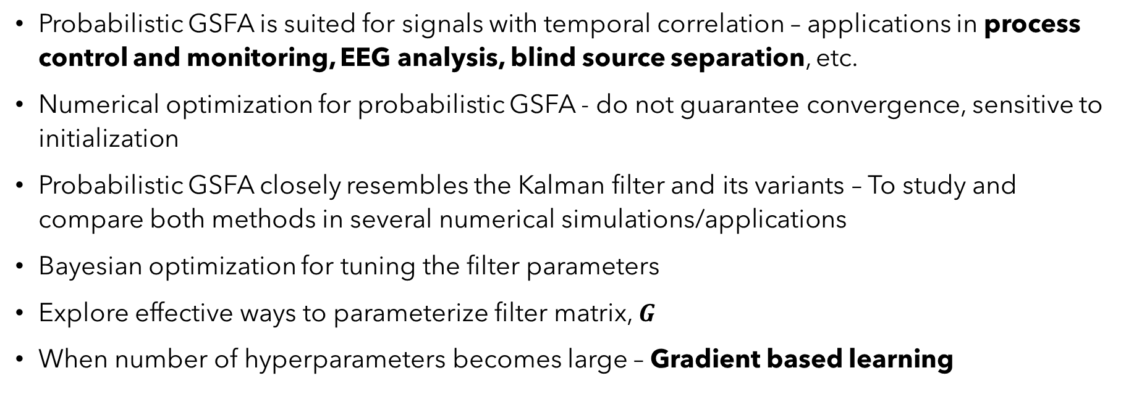
Work Ahead
Probabilistic GSFA is suited for signals with temporal correlation – applications in process control and monitoring, EEG analysis, blind source separation, etc.
Numerical optimization for probabilistic GSFA - do not guarantee convergence, sensitive to initialization
Probabilistic GSFA closely resembles the Kalman filter and its variants – To study and compare both methods in several numerical simulations/applications
Bayesian optimization for tuning the filter parameters
Explore effective ways to parameterize filter matrix, $G$
When number of hyperparameters becomes large – Gradient based learning

Slide 33
References
L. Wiskott and T. J. Sejnowski, "Slow feature analysis: unsupervised learning of invariances," Neural Comput, vol. 14, pp. 715-770, April 2002.
A. N. Escalante B. and L. Wiskott, "Slow Feature Analysis: Perspectives for Technical Applications of a Versatile Learning Algorithm," KI - Künstliche Intelligenz, vol. 26, November 2012.
A. Doumanoglou, N. Vretos and P. Daras, "Frequency–based slow feature analysis," Neurocomputing, vol. 368, pp. 34-50, 2019.
R. Turner and M. Sahani, "A Maximum-Likelihood Interpretation for Slow Feature Analysis," Neural computation, vol. 19, pp. 1022-38, May 2007.
A. N. Escalante B. and L. Wiskott, "How to Solve Classification and Regression Problems on High-Dimensional Data with a Supervised Extension of Slow Feature 31 Analysis," Journal of Machine Learning Research, vol. 14, pp. 3686-3719, December 2013.
L. Wiskott, Estimating Driving Forces of Nonstationary Time Series with Slow Feature Analysis, arXiv, 2003.
C. Shang, B. Huang, F. Yang and D. Huang, "Slow feature analysis for monitoring and diagnosis of control performance," Journal of Process Control, vol. 39, pp. 21-34, 2016.
N. Van der Aa, H. G. Morsche and R. R. M. Mattheij, "Computation of eigenvalue and eigenvector derivatives for a general complex-valued eigensystem," ELA. The Electronic Journal of Linear Algebra [electronic only], vol. 16, September 2007.
Huang, J., X. Yang, Y. A. W. Shardt, and X. Yan (2020). Fault classification in dynamic processes using multiclass relevance vector machine and slow feature analysis. IEEE Access, 8, 9115–9123.

Slide 34
Thank you!!

Slide 35
Appendix

Slide 36
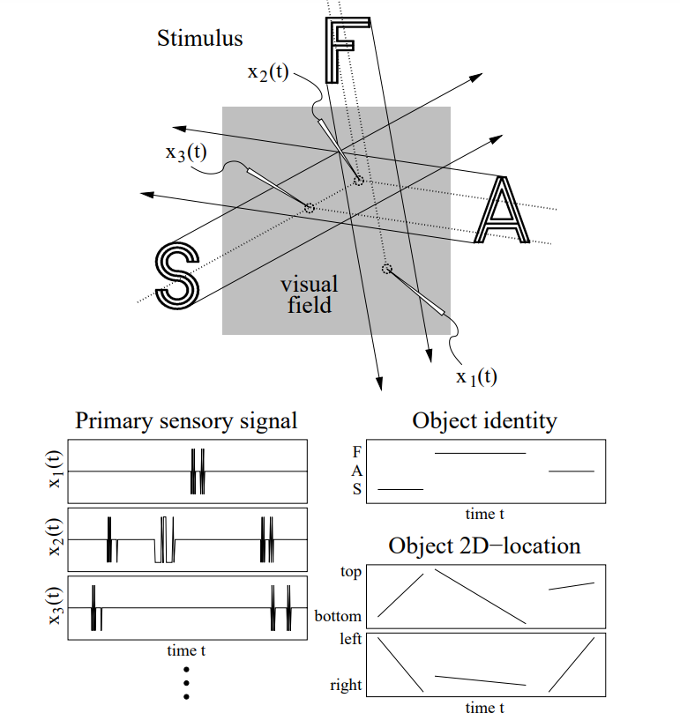
Slowness Principle
Figure illustrating the relation between slowly varying stimulus and quickly varying sensor activities. Three different objects, the letters S, F, and A, move straight through the visual field one by one.

Slide 37
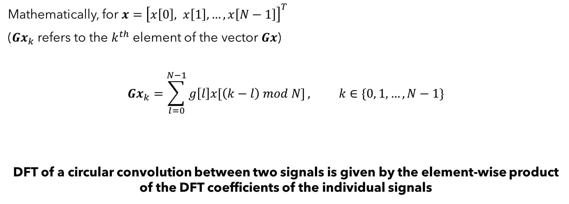
Special Remarks on the Filter, $G$
Mathematically, for $x={\left[x\left[0\right], x\left[1\right], …, x\left[N−1\right]\right]}^{T}$
($Gx_{k}$ refers to the $k^{th}$ element of the vector $Gx$)
$$Gx_{k}=\sum_{l=0}^{N−1}{g\left[l\right]x[\left(k−l\right) mod N]}, k∈\{0, 1, …, N−1\}$$
DFT of a circular convolution between two signals is given by the element-wise product of the DFT coefficients of the individual signals
(9)
(circular convolution)

Slide 38
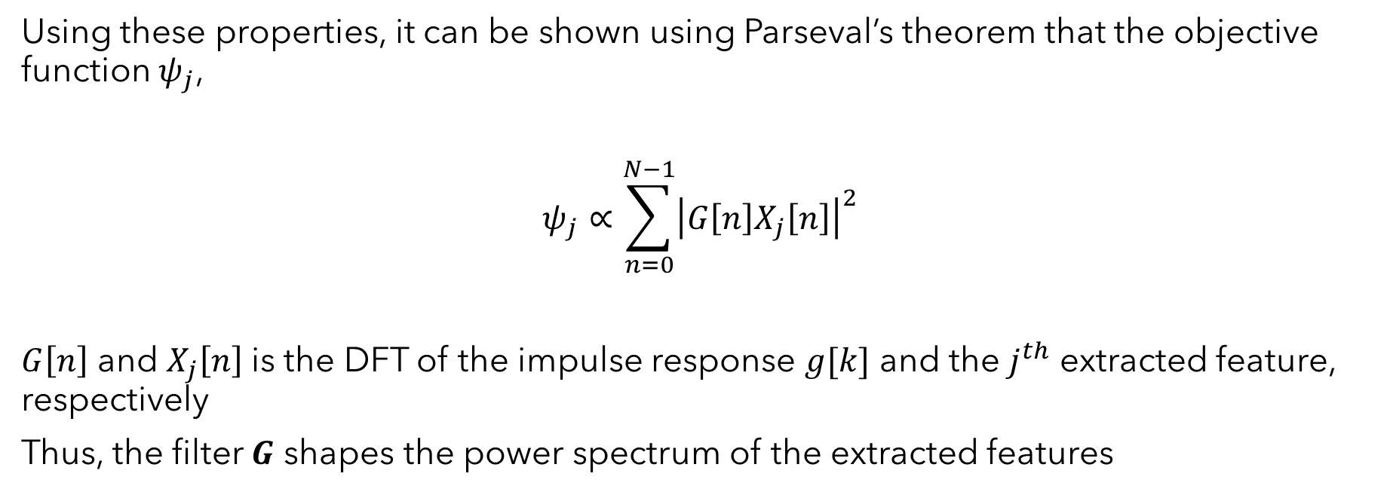
Special Remarks on the Filter, $G$
Using these properties, it can be shown using Parseval’s theorem that the objective function $ψ_{j}$,
$$ψ_{j}∝\sum_{n=0}^{N−1}{{\left|G\left[n\right]X_{j}\left[n\right]\right|}^{2}}$$
$G\left[n\right]$ and $X_{j}\left[n\right]$is the DFT of the impulse response $g[k]$ and the $j^{th}$ extracted feature, respectively
Thus, the filter $G$ shapes the power spectrum of the extracted features
(10)

Slide 39

State Estimation – DGP 1
$$y\left[k\right]=\left[\begin{matrix}1.539 & −0.742 & 0.783 \\ 0.467 & −0.664 & −0.861 \\ 0.786 & −0.894 & −0.428\end{matrix}\right]x\left[k\right]+ε\left[k\right]$$
$$x_{1}\left[k\right]=\frac{1−0.5q^{−1}}{1+0.2q^{−1}}e_{1}\left[k\right]$$
$$x_{2}\left[k\right]=\frac{1−0.8q^{−1}}{1−0.6q^{−1}}e_{2}\left[k\right]$$
$$x_{3}\left[k\right]=\frac{1−0.1q^{−1}}{1+0.4q^{−1}}e_{3}\left[k\right]$$
Here,
$e\left[k\right]={\left[e_{1}\left[k\right],e_{2}\left[k\right],e_{3}\left[k\right]\right]}^{T}\sim GWN\left(0,diag\left(\text{0.6621, 0.9412, 0.7706}\right)\right)$
$ε\left[k\right]\sim GWN\left(0,0.2802I_{3×3} \right)$

Slide 40

State Estimation – DGP 2
Standard SFA is the limiting case of probabilistic SFA
In probabilistic SFA, the latent signals evolve as an AR(1) process (Turner and Sahani (2007))
SFA (or probabilistic SFA) is not suited for a DGP whose latent signals evolve through a different process (MA/ARMA/higher order AR)
To make a fair comparison between SFA and probabilistic GSFA, we perform the experiments for the following DGP
$$y\left[k\right]=\left[\begin{matrix}−0.216 & −0.910 & 0.353 \\ 0.002 & −0.362 & −0.932 \\ 0.976 & −0.201 & 0.080\end{matrix}\right]x\left[k\right]+ε\left[k\right]$$
$$x_{1}\left[k\right]=\frac{1}{1−0.1q^{−1}}e_{1}\left[k\right]$$
$$x_{2}\left[k\right]=\frac{1}{1−0.2q^{−1}}e_{2}\left[k\right]$$
$$x_{3}\left[k\right]=\frac{1}{1−0.3q^{−1}}e_{3}\left[k\right]$$
Here,
$e\left[k\right]={\left[e_{1}\left[k\right],e_{2}\left[k\right],e_{3}\left[k\right]\right]}^{T}\sim GWN\left(0,diag\left(\text{0.}\text{99}\text{, 0.9}\text{6}\text{, 0.}\text{91}\right)\right)$
$ε\left[k\right]\sim GWN\left(0,0.20I_{3×3} \right)$

Slide 41
GTSRB - Methodology
Preprocessing:
The images were resized to 64 × 128 dimensions
The HOG (Histogram of Oriented Gradients) features were computed (which resulted in a vector of size 3780)
We used PCA to further reduce the dimensionality to 200 (as it explained > 75% of the total variance of the training data)
To employ methods like SFA, GSFA, and probabilistic GSFA, we sort the training data (and not the test data) according to their class labels.

Slide 42
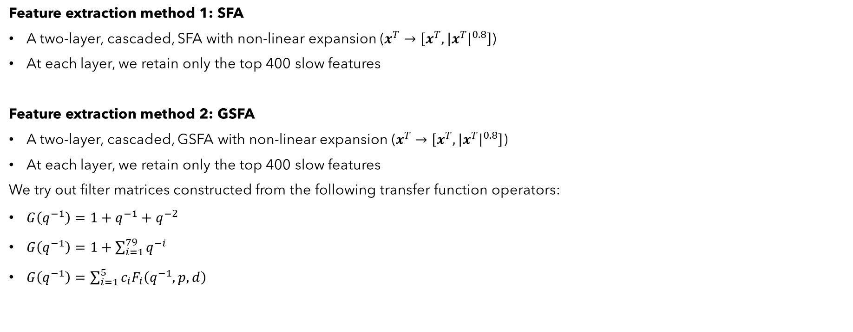
GTSRB - Methodology
Feature extraction method 1: SFA
A two-layer, cascaded, SFA with non-linear expansion ($x^{T}→\left[x^{T},{\left|x^{T}\right|}^{0.8}\right]$)
At each layer, we retain only the top 400 slow features
Feature extraction method 2: GSFA
A two-layer, cascaded, GSFA with non-linear expansion ($x^{T}→\left[x^{T},{\left|x^{T}\right|}^{0.8}\right]$)
At each layer, we retain only the top 400 slow features
We try out filter matrices constructed from the following transfer function operators:
$G\left(q^{−1}\right)=1+q^{−1}+q^{−2}$
$G\left(q^{−1}\right)=1+\sum_{i=1}^{79}{q^{−i}}$
$G\left(q^{−1}\right)=\sum_{i=1}^{5}{c_{i}F_{i}\left(q^{−1},p,d\right)}$

Slide 43

GTSRB - Methodology
Feature extraction method 3: Probabilistic GSFA
We try the following different functions for $f_{φ}\left(.\right)$ and $μ_{θ_{1}}\left(.\right)$:
$f_{φ}\left(.\right)$ and $μ_{θ_{1}}\left(.\right)$ are linear with $P = M = 200$
$f_{φ}\left(.\right)$ and $μ_{θ_{1}}\left(.\right)$ are linear with $P = 400$
$f_{φ}\left(.\right)$ and $μ_{θ_{1}}\left(.\right)$ are two-layered neural networks (Tanh activation in between) with $P = 800$
$f_{φ}\left(.\right)$ and $μ_{θ_{1}}\left(.\right)$ are two-layered neural networks (Tanh activation in between) with $P =1200$
We try out the following filters:
$Λ_{j}\left(q^{−1}\right)=b_{j}q^{−1}+d_{j}q^{−2}$
$Λ_{j}\left(q^{−1}\right)=\sum_{i=1}^{79}{b_{ij}q^{−i}}$
$Λ_{j}\left(q^{−1}\right)=\frac{b_{j}q^{−1}}{(1−d_{j}q^{−1})}$

Slide 44
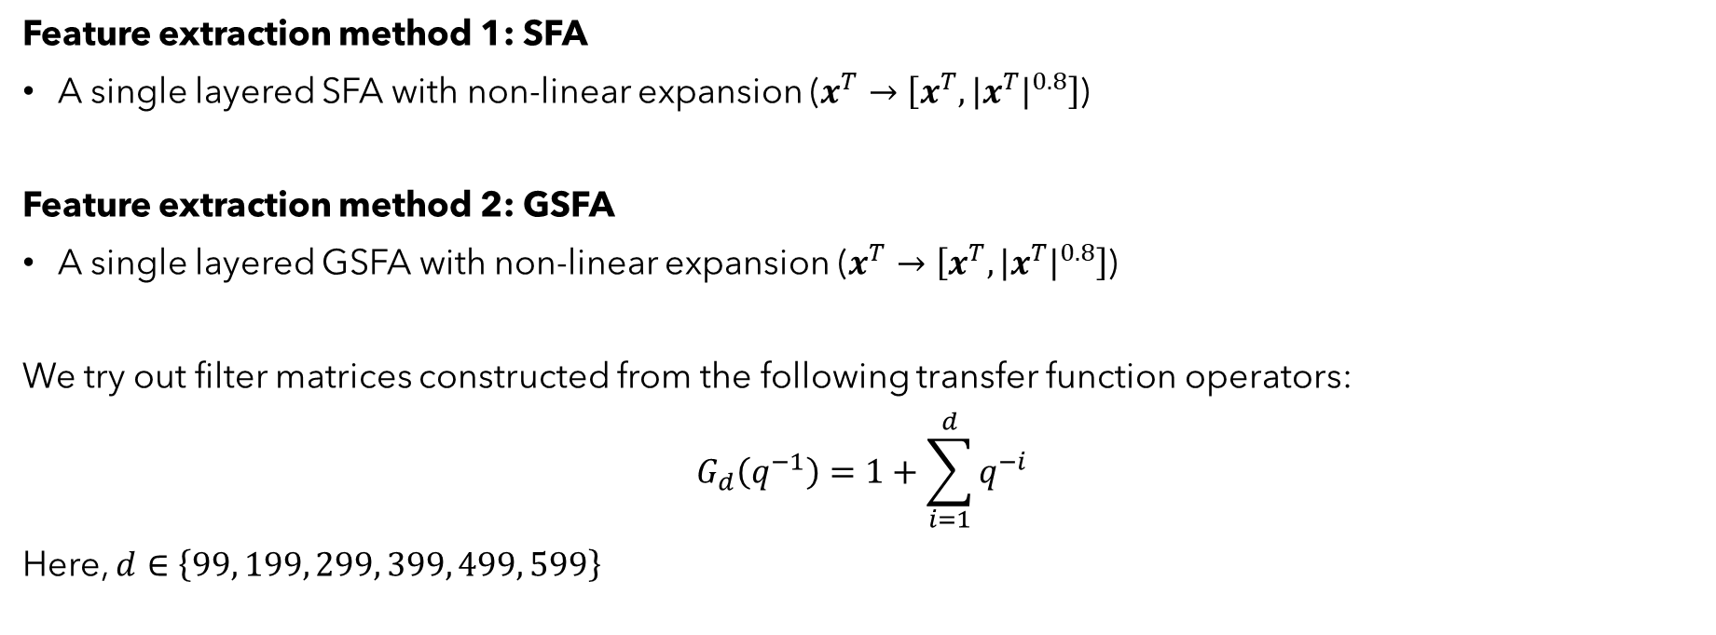
Fault Classification in TE Process - Methodology
Feature extraction method 1: SFA
A single layered SFA with non-linear expansion ($x^{T}→\left[x^{T},{\left|x^{T}\right|}^{0.8}\right]$)
Feature extraction method 2: GSFA
A single layered GSFA with non-linear expansion ($x^{T}→\left[x^{T},{\left|x^{T}\right|}^{0.8}\right]$)
We try out filter matrices constructed from the following transfer function operators:
$$G_{d}\left(q^{−1}\right)=1+\sum_{i=1}^{d}{q^{−i}}$$
Here, $d∈\left\{99, 199, 299, 399, 499, 599\right\}$

Slide 45

Fault Classification in TE Process - Methodology
Feature extraction method 3: Probabilistic GSFA
We try the following different functions for $f_{φ}\left(.\right)$ and $μ_{θ_{1}}\left(.\right)$:
$f_{φ}\left(.\right)$ and $μ_{θ_{1}}\left(.\right)$ are linear with $P = M =52$
$f_{φ}\left(.\right)$ and $μ_{θ_{1}}\left(.\right)$ are linear with $P =100$
$f_{φ}\left(.\right)$ and $μ_{θ_{1}}\left(.\right)$ are linear with $P =200$
$f_{φ}\left(.\right)$ and $μ_{θ_{1}}\left(.\right)$ are linear with $P =300$
We try out the following filters:
$Λ_{j}\left(q^{−1}\right)=\sum_{i=1}^{50}{b_{ij}q^{−i}}$
$Λ_{j}\left(q^{−1}\right)=\sum_{i=1}^{100}{b_{ij}q^{−i}}$
$Λ_{j}\left(q^{−1}\right)=\frac{b_{j}q^{−1}}{(1−d_{j}q^{−1})}$

Slide 46
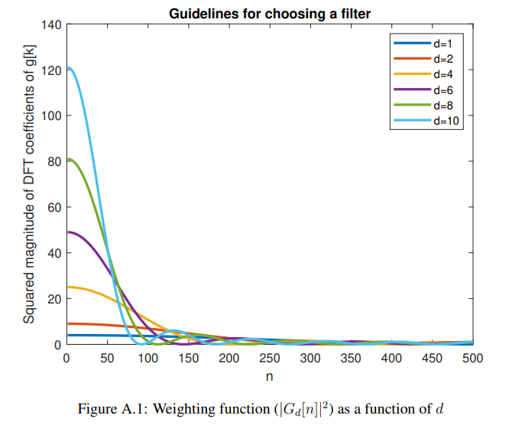
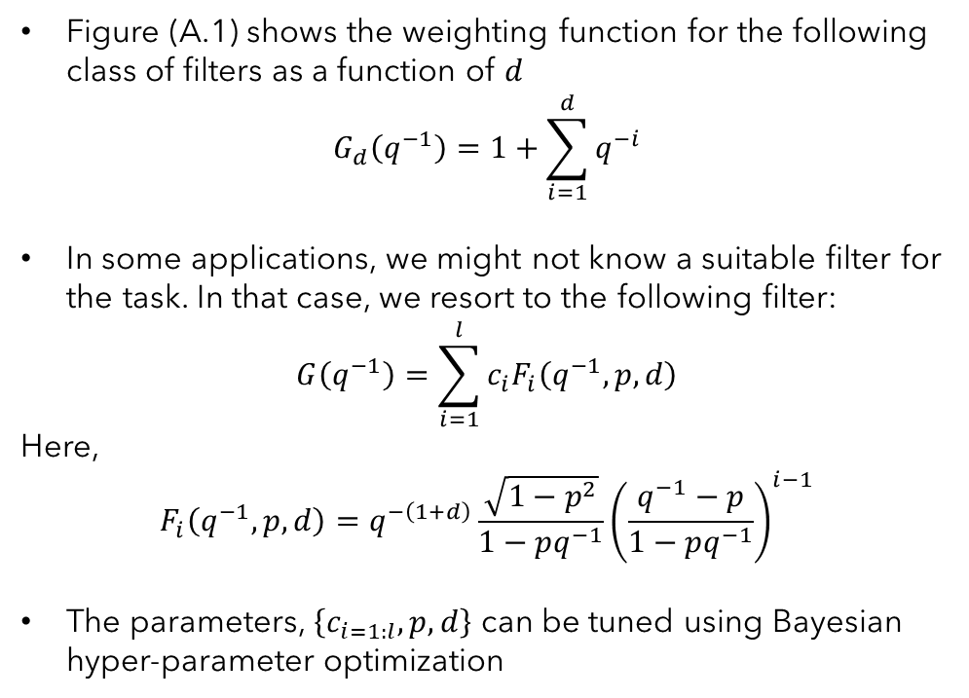
Guidelines for choosing the filter - GSFA
Figure (A.1) shows the weighting function for the following class of filters as a function of $d$
$$G_{d}\left(q^{−1}\right)=1+\sum_{i=1}^{d}{q^{−i}}$$
In some applications, we might not know a suitable filter for the task. In that case, we resort to the following filter:
$$G\left(q^{−1}\right)=\sum_{i=1}^{l}{c_{i}F_{i}\left(q^{−1},p,d\right)}$$
Here,
$$F_{i}\left(q^{−1},p,d\right)=q^{−\left(1+d\right)}\frac{\sqrt{1−p^{2}}}{1−pq^{−1}}{\left(\frac{q^{−1}−p}{1−pq^{−1}}\right)}^{i−1}$$
The parameters, $\left\{c_{i=1:l},p,d\right\}$ can be tuned using Bayesian hyper-parameter optimization

Slide 47
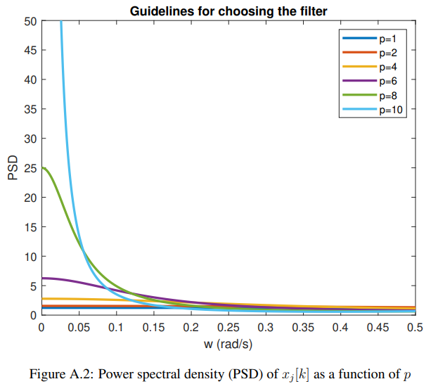
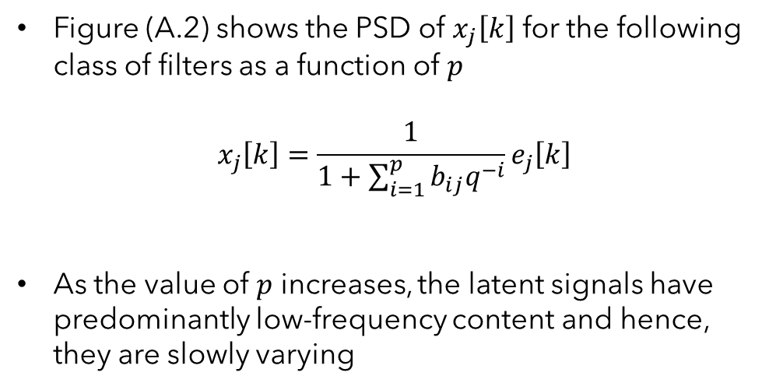
Guidelines for choosing the filter – Probabilistic GSFA
Figure (A.2) shows the PSD of $x_{j}\left[k\right]$ for the following class of filters as a function of $p$
$$x_{j}\left[k\right]=\frac{1}{1+\sum_{i=1}^{p}{b_{ij}q^{−i}}}e_{j}\left[k\right]$$
As the value of $p$ increases, the latent signals have predominantly low-frequency content and hence, they are slowly varying

